Slide 1
Introduction to Machine Learning
Dr. Vishan Kumar Gupta
Associate Professor
Computer Science and Engineering Department
Graphic Era Deemed to be University, Ghaziabad
vishangupta@gmail.com

Slide 2
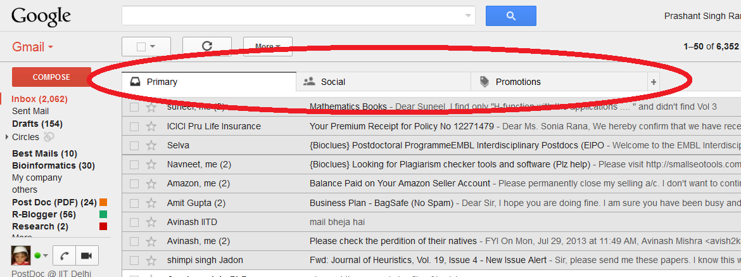
What is Machine Learning ?
Example1: Email classification in Gmail

Slide 3
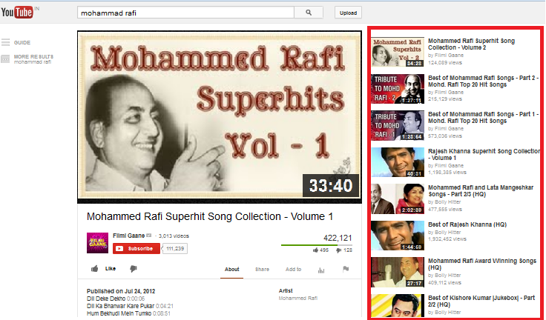
What is Machine Learning ?
Example2: Suggestions in youtube

Slide 4

What is Machine Learning ?
Example3: suggestions in reply according to the contents of e-mail

Slide 5
What is Learning ?
Definition:- The ability to improve one’s behavior based on experience.

Slide 6
What is Machine Learning ?
Simple Definition I - Branch of Artificial Intelligence that gives computers to learn without being explicitly programmed.
Simple Definition II - Branch of Artificial Intelligence, about to construct a system that learn from data.

Slide 7
What is Machine Learning ?
Algorithm Machine Learning
Data Program Data Output
Computer
Computer
Output
Program(Model)

Slide 8
According to Arthur Samuels
Actual Definition - A computer program is said to learn from experience E with respect to some task T and some performance measure P, if its performance on T, as measured by P, improves with experience E.
For example:-
Task: Cricket score prediction between India and England.
Experience: Old data of India between England match/pitch/members of team.
Performance: How actually you predict.

Slide 9
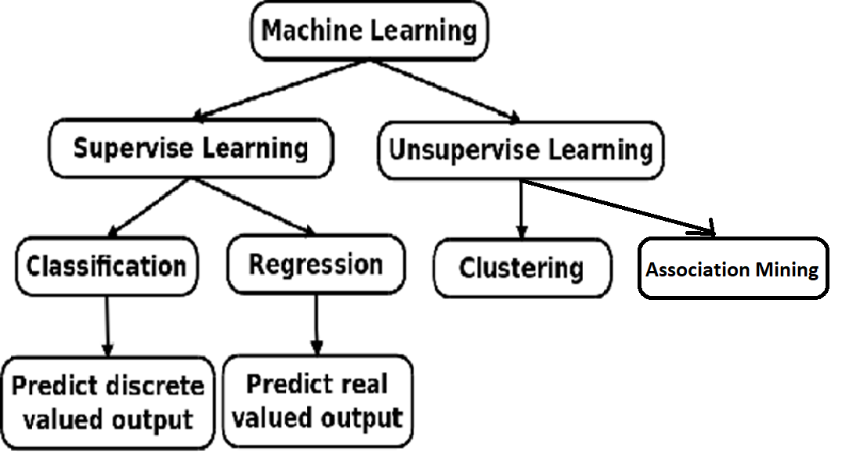
Categories of Machine Learning

Slide 10
Supervised/Unsupervised Learning
Supervised Learning is applied when the input data collected has some kind of known labels or results. input data is called training data and model is prepared by using this data.
Example: Classification & Regression Problems.

Slide 11
Supervised/Unsupervised Learning
Unsupervised Learning refers to the problem of trying to find hidden structure in unlabeled data.
Example: Clustering Problems and Association Rule Mining.

Slide 12
Examples
Classification Problems
Prediction of cancer.
Win prediction of Mr. Narendra Modi.
Diabetic Prediction.
Classification of e-mail spam or not-spam.
Regression Problem
Prediction of wheat production.
Prediction of rainfall.
Point prediction of Stock Exchange.

Slide 13
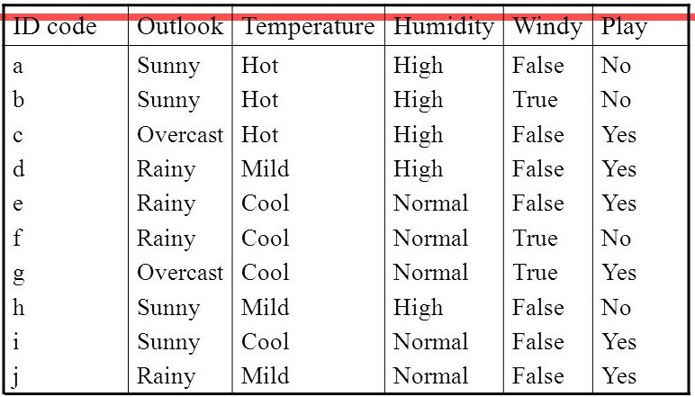
Data for playing Tennis according to weather

Slide 14
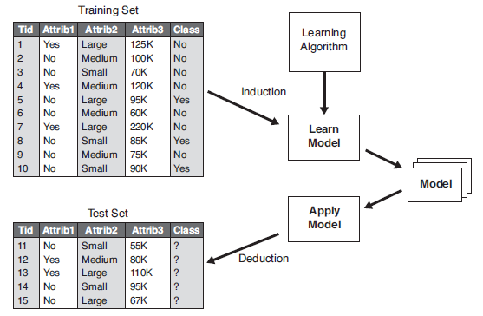
Classification
A classification technique is a systematic approach to building classification models from an input data set. Decision tree, neural networks, linear model, random forest and support vector machines are the classifiers.

Slide 15
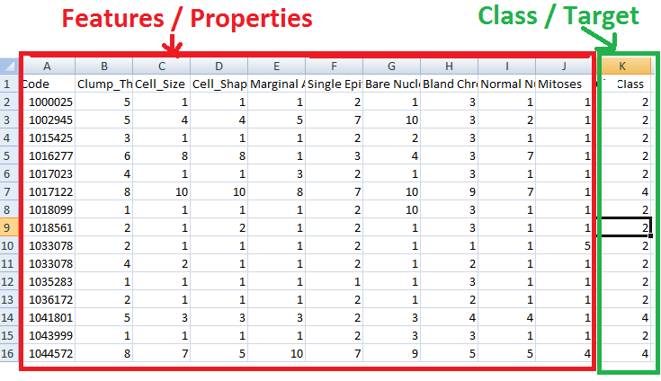
Understand the Data……..

Slide 16
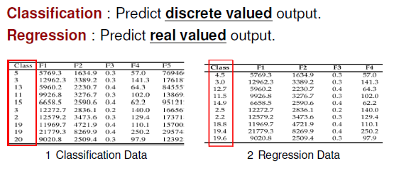
Classification & Regression

Slide 17
Machine Learning models
Most Common models
Decision tree model
Random forest
SVM (Support Vector Machine)
Linear model
Neural network
AdaBoost

Slide 18
Examples
Clustering:- Clustering is the task of dividing the population or data points into a number of groups such that data points in the same groups are more similar to other data points and dissimilar to the data points in other groups. It is basically a collection of objects on the basis of similarity and dissimilarity between them.
Grouping of NEWS.
Grouping the people on their similar hobbies/interests.
Grouping of animals.
Grouping of customers based on their performance. e.g. bank customers.
………….. Many more.

Slide 19
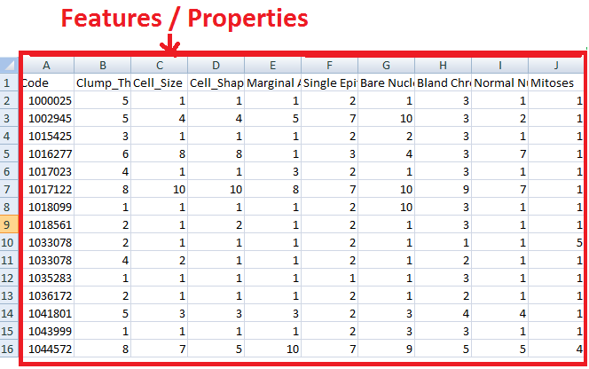
Clustering Data
Only Features; No class/target/label

Slide 20
Examples
Association Rule Mining:-Association rule mining is a procedure which aims to observe frequently occurring patterns, correlations, or associations from datasets found in various kinds of databases such as relational databases, transactional databases, and other forms of repositories.
Market Basket Analysis
Medical Diagnosis
Census Data
Protein Sequence
……….. Many more.

Slide 21
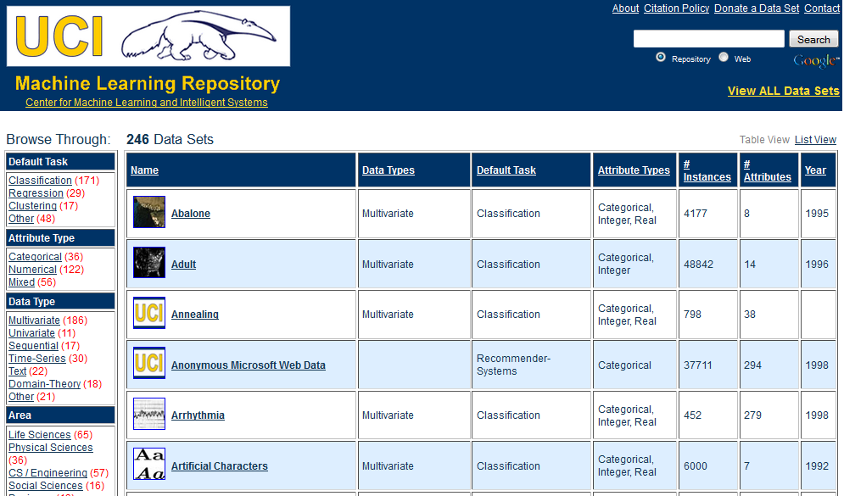
Data Set : UCI Library (Datasets Repository)
Google→ “uci dataset”

Slide 22
Flow of Machine Learning based Application
Data collection
Data cleansing
Feature selection
Division of data into training and testing
K-fold cross validation
Result analysis

Slide 23
Thanks

